Slide 1
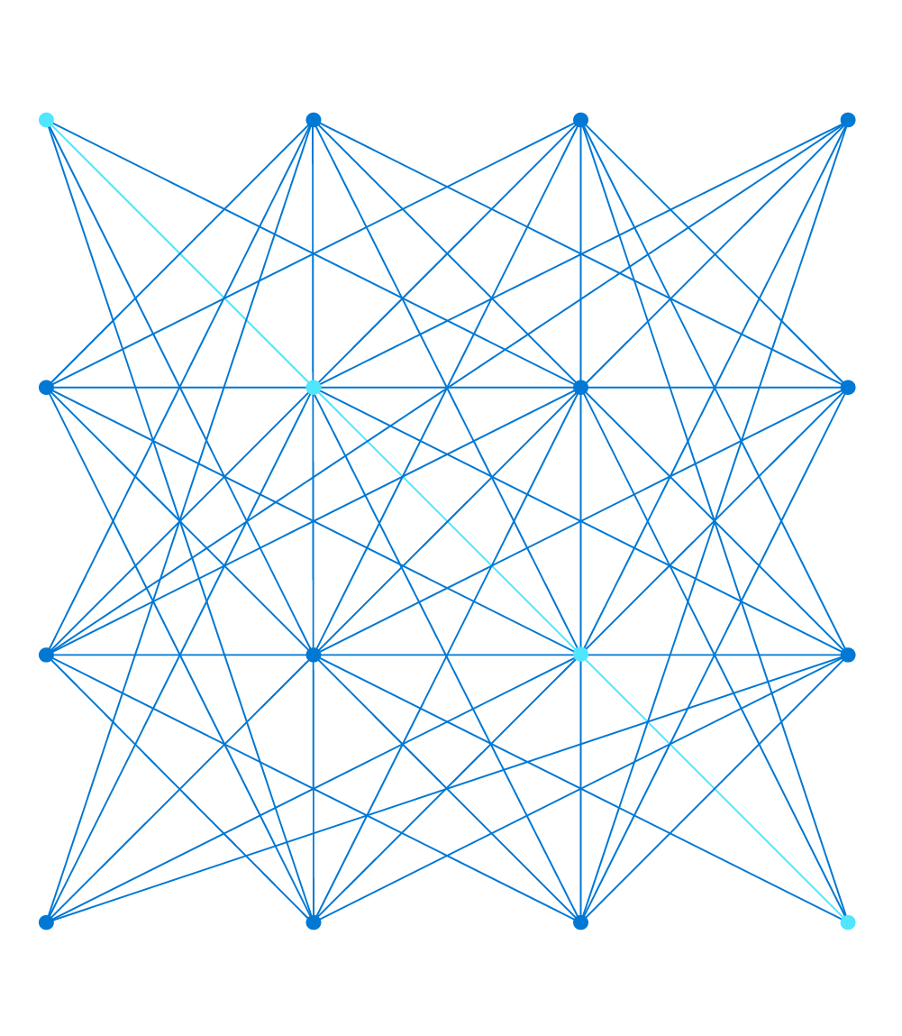
AZ-303: Microsoft Azure Architect Technologies
Presenter, MCT

Slide 2
Module 2: Implement VMs for Windows and Linux
Azure Dedicated Hosts, Scale Sets, Disk Encryption, and High Availability

Slide 3
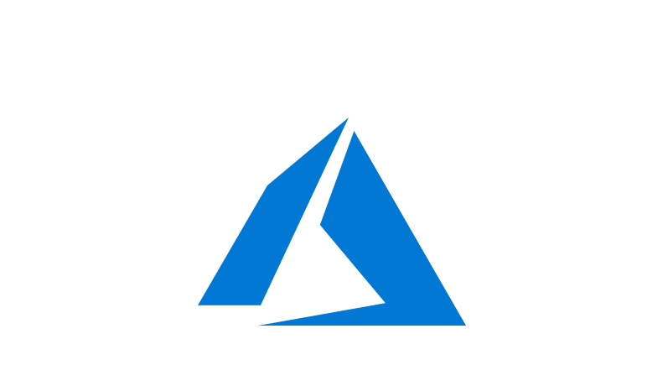
Learning Objectives
You will learn the following:
Running Linux and Windows Virtual Machines on Azure
Select Virtual Machine Size
Configure High Availability
Implement Azure Dedicated Hosts
Deploy and Configure Scale Sets
Configure Azure Disk Encryption

Slide 4
Overview: Running Linux and Windows Virtual Machines on Azure

Slide 5

Checklist for creating an Azure Virtual Machine
Required resources for IaaS Virtual Machines:
Start with the network
Name the VM
Decide the location for the VM
Determine the size of the VM
Understanding the pricing model
Storage for the VM
Select an operating system

Slide 6

Start with the Network
Segregate the network
Create one or more subnets
Secure the network
Create and assign Network Security Groups (NSGs)
Plan each VM deployment

Slide 7
Naming the VM (1 of 2)
Naming convention considerations:
The VM name is configured as part of the operating system.
This name defines a manageable Azure resource—not trivial to change later.
Recommended naming conventions include the following:
Element | Example | Notes
Environment | dev, prod, QA | The environment for the resource
Location | uw (US West), ue (US East) | The Azure region
Instance | 01, 02 | Instance of a resource
Product or service | Service | Product, application, or service that resource supports
Role | sql, web, messaging | Role of the resource

Slide 8
Naming the VM (2 of 2)
A VM deployment includes several resources:
The VM itself
Storage account for the disks
Virtual network (shared with other VMs and services)
Network interface to communicate on the network
Network Security Group(s) to secure network traffic
Public internet address (optional)

Slide 9
Decide the Location of the VM
Azure has datacenters all over the world
Datacenters are grouped into geographic regions
Select a region where you want the resources to be allocated

Slide 10
Determine the Size of the VM (1 of 2)
Azure provides different VM sizes that offer variations of
Processing power
Memory
Storage capacity
Azure provides a wide range of VM size options
General purpose
Compute optimized
Memory optimized
Storage optimized
GPU
High performance compute

Slide 11
Determine the Size of the VM (2 of 2)
Option | Description
General purpose | Balanced CPU-to-memory ratio. Ideal for testing and development, small to medium databases, and low to medium traffic web servers.
Compute optimized | High CPU-to-memory ratio. Suitable for medium traffic web servers, network appliances, batch processes, and application servers.
Memory optimized | High memory-to-CPU ratio. Great for relational database servers, medium to large caches, and in-memory analytics.
Storage optimized | High disk throughput and IO. Ideal for VMs running databases.
GPU | Heavy graphics rendering and video editing. These VMs are ideal options for model training and inferencing with deep learning.
High performance compute | The fastest and most powerful CPU with optional high-throughput network interfaces.

Slide 12
Virtual Machine Sizes (Windows and Linux)
Type | Sizes | Description
General purpose | B, Dsv3, Dv3, Dasv4, Dav4, DSv2, Dv2, Av2, DC, DCv2, Dv4, Dsv4, Ddv4, Ddsv4 | Balanced CPU-to-memory ratio. Ideal for testing and development, small to medium databases, and low to medium traffic web servers.
Compute optimized | Fsv2 | High CPU-to-memory ratio. Good for medium traffic web servers, network appliances, batch processes, and application servers.
Memory optimized | Esv3, Ev3, Easv4, Eav4, Ev4, Esv4, Edv4, Edsv4, Mv2, M, DSv2, Dv2 | High memory-to-CPU ratio. Great for relational database servers, medium to large caches, and in-memory analytics.
Storage optimized | Lsv2 | High disk throughput and IO ideal for Big Data, SQL, NoSQL databases, data warehousing and large transactional databases.
GPU | NC, NCv2, NCv3, ND, NDv2 (Preview), NV, NVv3, NVv4 | Specialized virtual machines targeted for heavy graphic rendering and video editing, as well as model training and inferencing (ND) with deep learning. Available with single or multiple GPUs.
High performance compute | HB, HBv2, HC, H | Our fastest and most powerful CPU virtual machines with optional high-throughput network interfaces (RDMA).

Slide 13
The Pricing Model
There are two separate costs charged for every VM
Compute costs
Storage costs
There are two main payment options for compute costs
Pay as you go
Reserved Virtual Machine instances

Slide 14
Select an Operating System
Azure provides a variety of OS images you can install into the VM, including:
All currently supported versions of Windows
All major Linux distributions
You can search Azure Marketplace for more install images
You can create your own custom images to create Azure VMs

Slide 15



Storage for the VM
Each Azure VM has two or more disks:
OS disk
Temporary disk
Data disks (optional)
OS and data disks reside in Azure Storage accounts:
Azure-based storage service
Standard (HDD, SSD) or Premium (SSD), or Ultra (SSD)
When creating an Azure VM, you can choose between:
Managed disks (recommended)
Unmanaged disks
Azure VM (Windows)
C:\
Operating system disk
F:\
Data disk
D:\
Temporary disk
(contents can be lost)
Azure blob

Slide 16
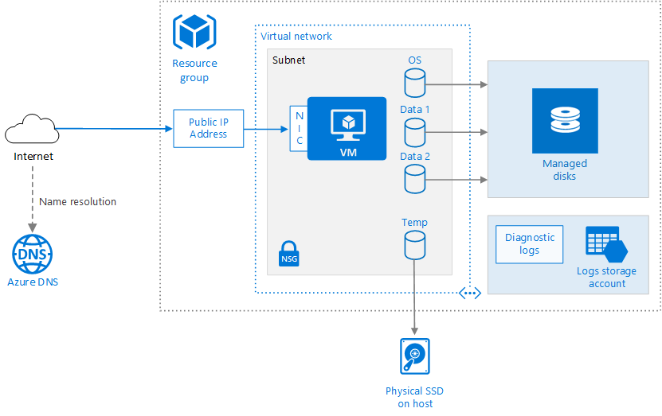
Running Linux and Windows Virtual Machines on Azure
Azure VM deployments includes other resources
Networking
Storage
Place related resources in the same resource group to simplify
Management
Cost tracking
deprovisioning

Slide 17
Configure High Availability

Slide 18
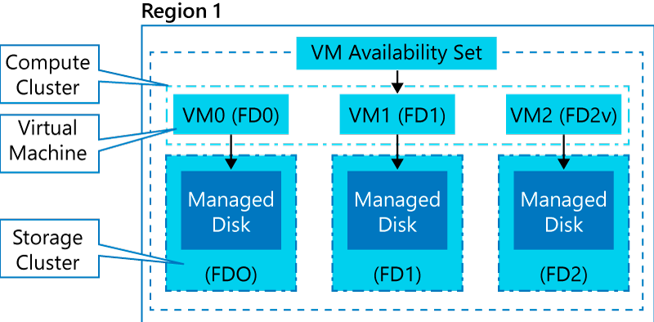
Availability Sets (1 of 2)
An availability set is a logical grouping of VMs within a datacenter:
Automatically distributes VMs across fault and update domains on compute clusters
With managed disks, it provides equivalent resiliency on storage clusters
Provides 99.95% availability SLA (for 2 or more VMs)

Slide 19
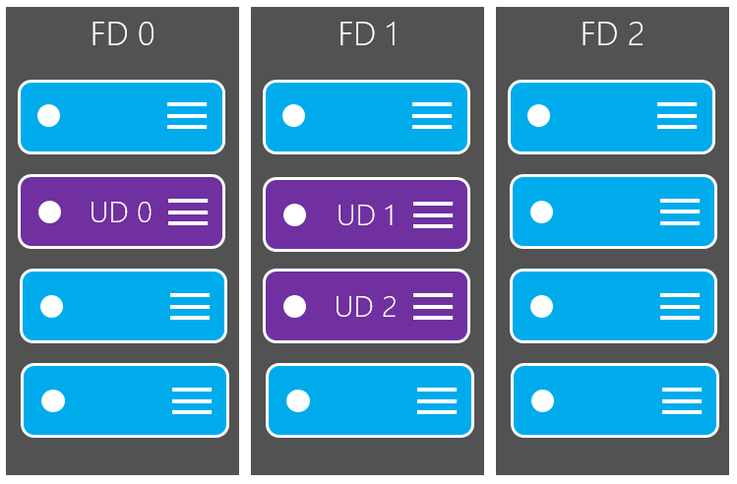
Availability Sets (2 of 2)

Slide 20
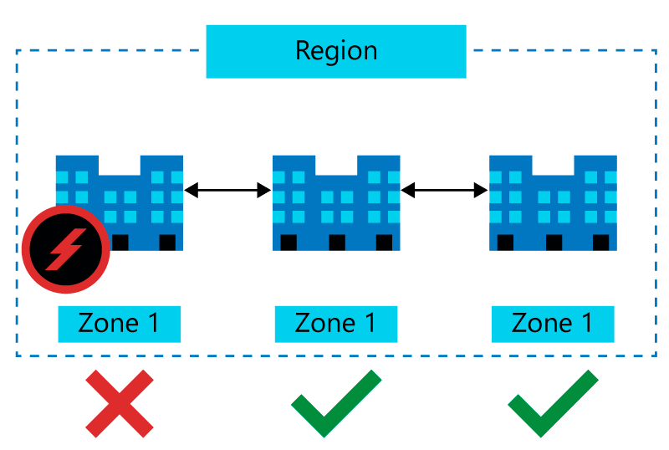
Availability Zones
Core concepts:
Availability zones
Fault domains
Update domains

Slide 21
Virtual Machine Scale Sets
Consist of identically configured, load balanced VMs
Support manual, scheduled and automatic scaling
Automatically distributes VMs across fault domains and update domains

Slide 22
Deploy and Configure Scale Sets

Slide 23
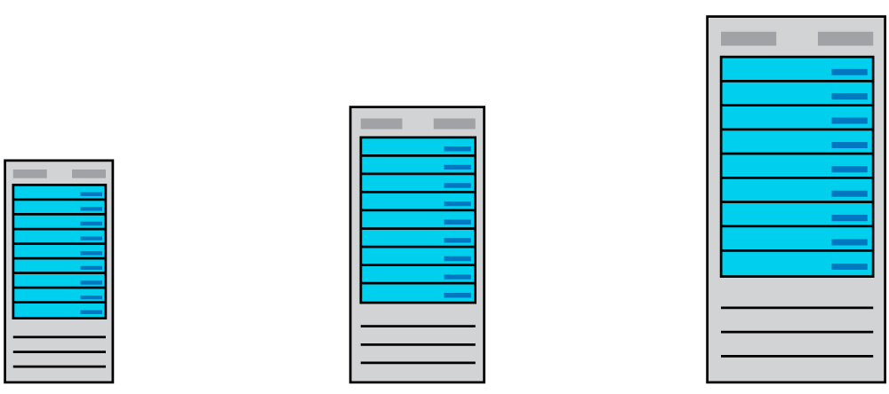
Scaling Concepts (1 of 2)
Vertical scaling

Slide 24
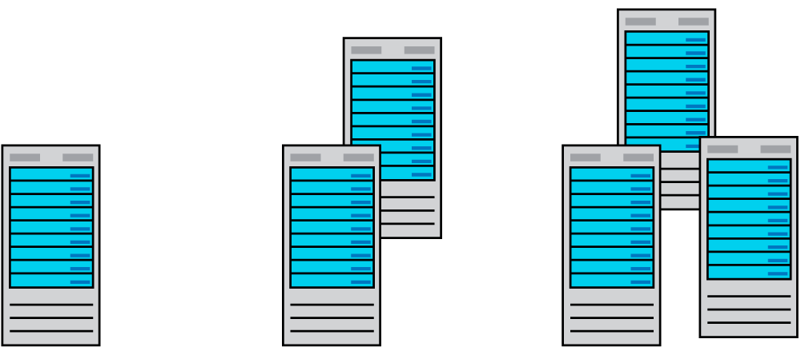
Scaling Concepts (2 of 2)
Horizontal scaling

Slide 25
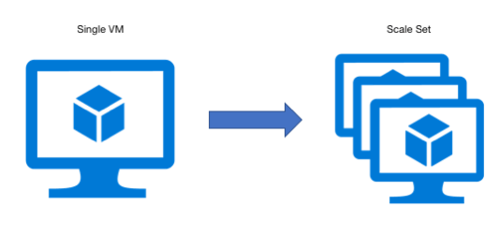
Scale Sets
Scale set benefits
Simplicity: All VM instances are created using the same based OS
Load balancer support: layer 4 and layer 7
High availability: multiple instances of the same workload
Autoscaling: the number of instances adjusts dynamically based on demand
Scalability: up to 1,000 VM instances (600 when using custom images)

Slide 26
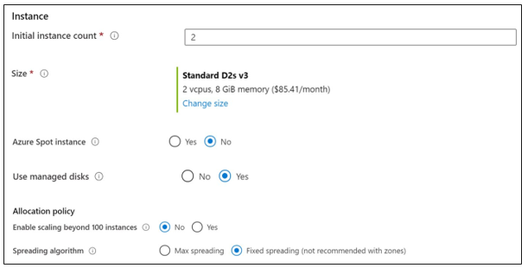
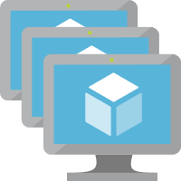
Implementing Scale Sets
Initial instance count
Instance size
Azure spot instance
Use managed disks
Enable scaling beyond 100 instances
Spreading algorithm

Slide 27
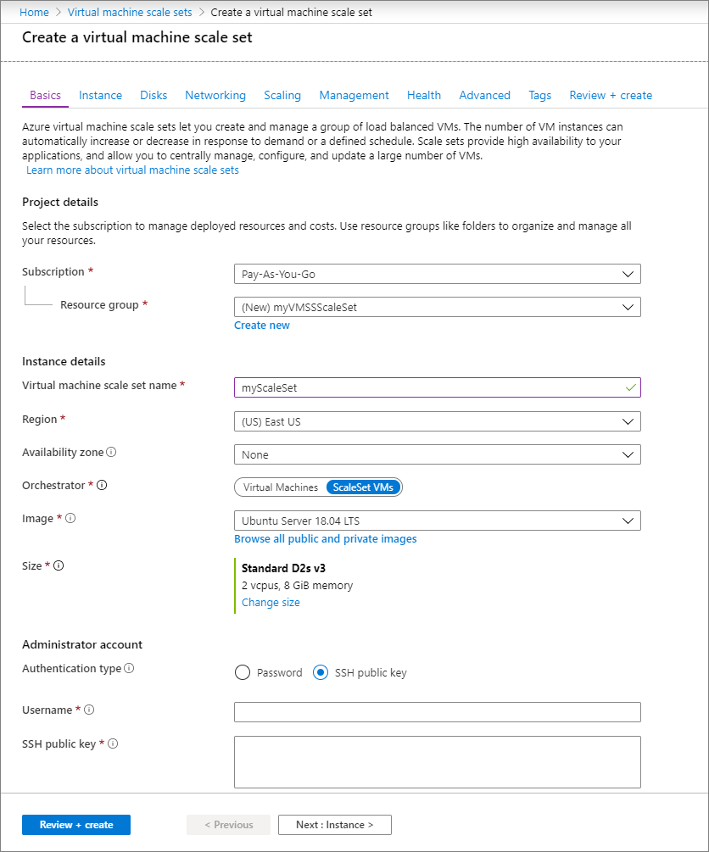
Create a VM Scale Set in the Azure Portal
Create a public load balancer
Create virtual machine scale set

Slide 28
Implement Azure VM Dedicated Hosts

Slide 29
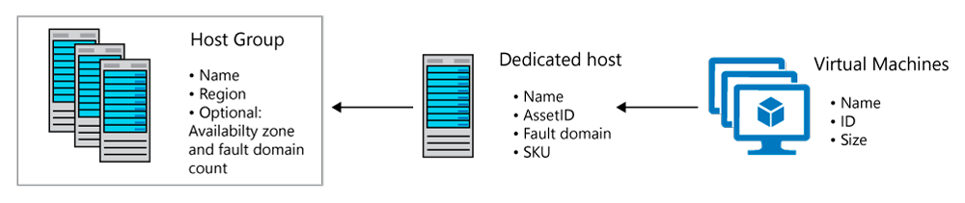
Azure Dedicated Hosts
Benefits:
Implement hardware isolation at the physical server level
Control impact of maintenance events initiated by the Azure platform
Notes:
Azure Dedicated Host is a service that provides physical servers - able to host one or more virtual machines - dedicated to one Azure subscription. Dedicated hosts are the same physical servers used in our data centers, provided as a resource. You can provision dedicated hosts within a region, availability zone, and fault domain. Then, you can place VMs directly into your provisioned hosts, in whatever configuration best meets your needs.

Slide 30
Configure Azure Disk Encryption

Slide 31
Azure Encryption Technologies
Two main encryption-based disk protection methods Azure VMs
Storage Service Encryption (SSE)
Azure Disk Encryption (ADE)
Storage Service Encryption (SSE)
enabled for all new and existing storage accounts
cannot be disabled
Azure Disk Encryption (ADE)
managed by the VM owner
uses BitLocker on Windows VMs and DM-Crypt on Linux VMs
stores encryption keys in Azure Key Vault

Slide 32

Module 2 Review Questions

Slide 33
Online Role-based training resources: Microsoft Learn https://docs.microsoft.com/en-us/learn/

Slide 34
Thank you.

